Slide 1
Welcome! Read this entire slide, then go to the Slide Show tab and click “From Beginning”.
This slide is for you, the presenter; it won’t appear during the talk.
Make sure to use Presenter View so you can see Notes for each slide (three dots in the lower-left allow you to enter Presenter View).
Show Slide 2 as students wait for you to begin. Music on this slide sets the tone and acts as a sound check.
In Notes sections, text in quotes means it’s part of the “script,” while normal text is there for you as a guide.
Finally, this pdf has sources and more information for each slide.
Watch a team member deliver the presentation here.
Notes:
Downloaded from www.EarthDNA.org/Ambassadors.

Slide 2


Please take out your phones.
Go to www.TinyURL.com/ClimateSurveyA.
Fill out the survey
(only if you feel comfortable doing so).
[Presenter’s name: Brandon Leshchinskiy]
Notes:
Leave this slide up as students wait for you to start. The survey is crucial for us to measure impact, and this slide also serves as a sound test.
Remember: pause before you click.
[This image is in the public domain.]

Slide 3
Notes:
This slide is here as a buffer between the survey slide and the attention-getting video on the next slide.

Slide 4
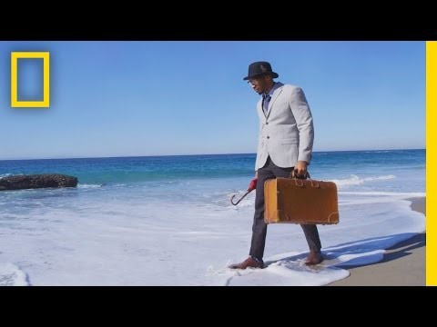
Prince Ea
Notes:
Be attentive and let this video affect you. Teach the audience how to watch your presentation.
Video link: https://www.youtube.com/watch?v=B-nEYsyRlYo

Slide 5

We Need to Talk.
By EarthDNA
Notes:
“Hi everyone! My name is ___, and just like you guys, I ___ (e.g. live in Pennsylvania). I’m a ___ (e.g. college student) studying ____ (e.g. engineering) at ___ (e.g. Penn State).
The presentation that you’re watching was made by a group called EarthDNA, which is based at MIT.
But it will be watched by thousands of high school students around the country.
So welcome!”
[This image is in the public domain.]

Slide 6
This talk will have audience interaction. To get you all warmed up, please yell out your name on 3!
Nice to meet you!
Notes:
“This talk will have audience interaction, so to get you all warmed up, please yell out your name on 3! Ready – 1, 2, 3! [PAUSE]” *click*
“Nice to meet you!”

Slide 7
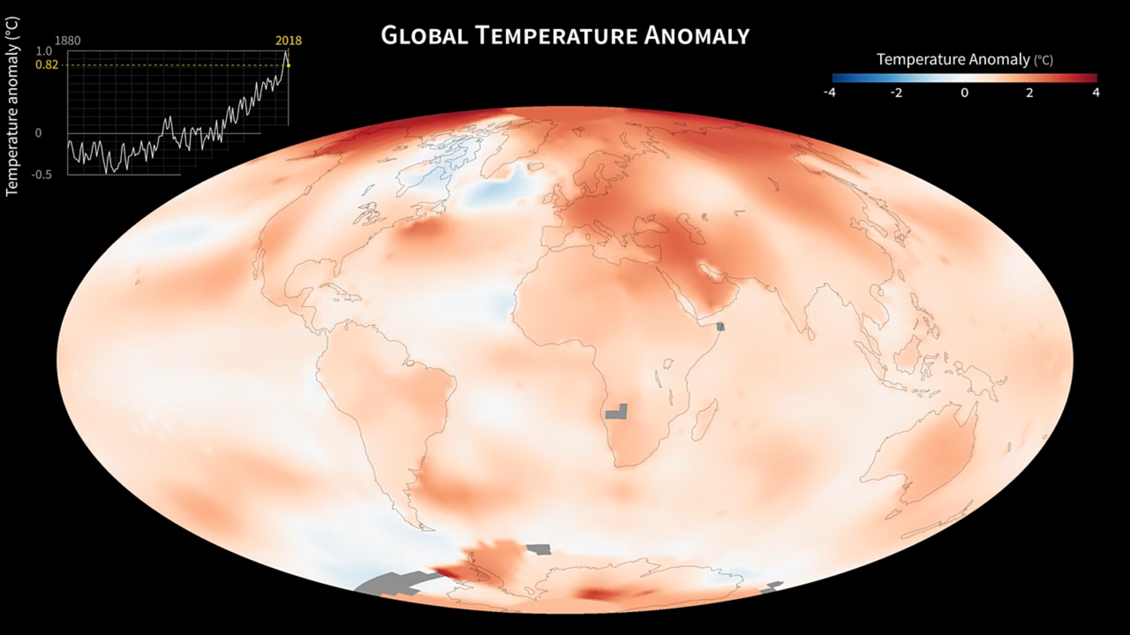
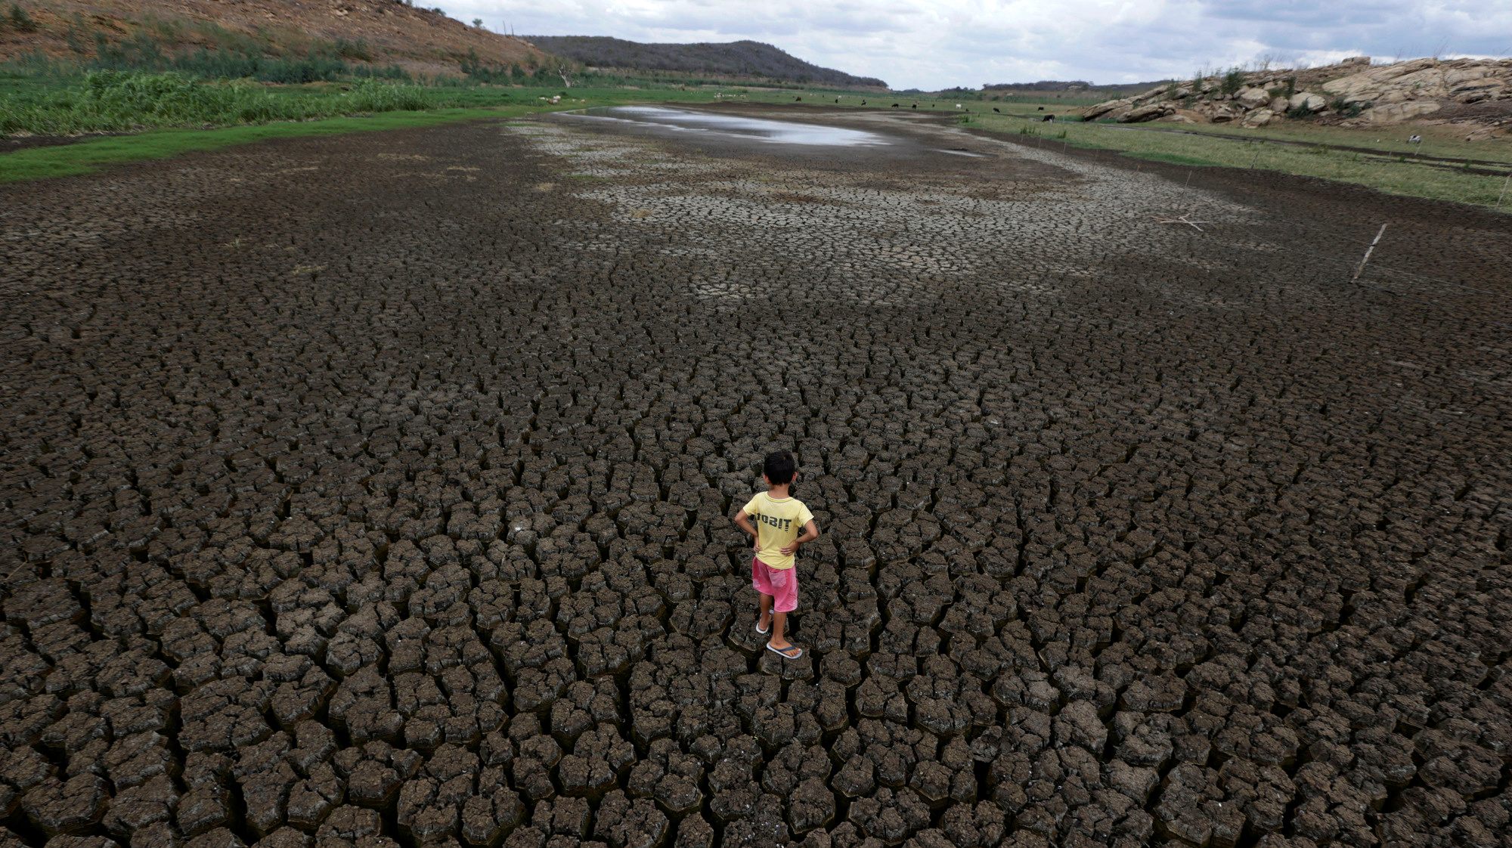
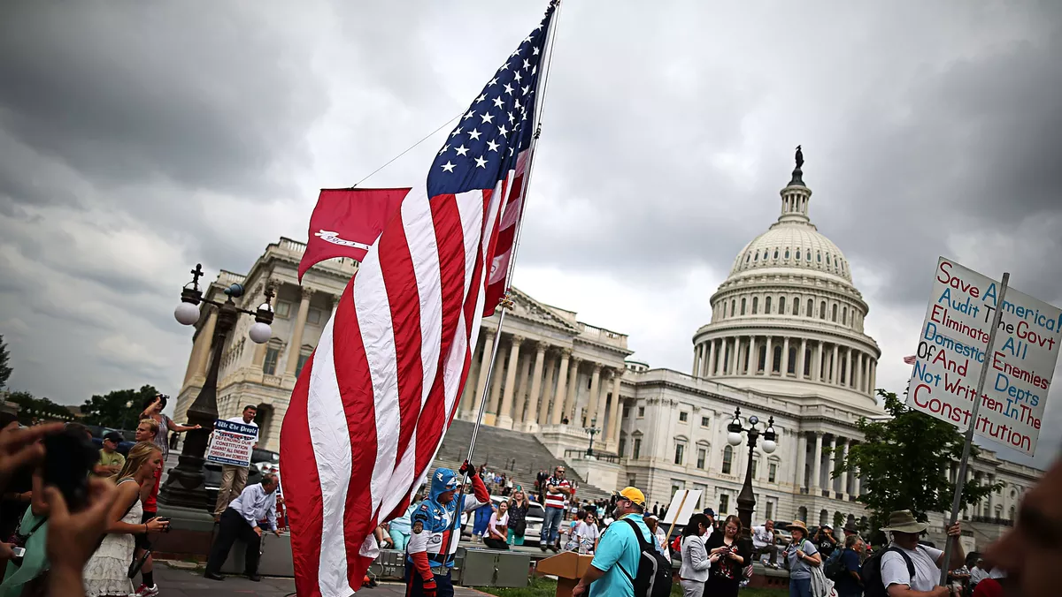
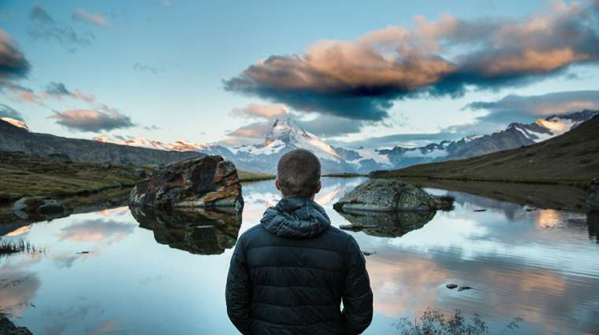
The Truth
The Consequences
The Myths
The Future
Notes:
“Today we need to talk about the Truth” *click*
“The consequences” *click*
“The lies” *click*
“and the future” *click*
[Upper left: public domain image courtesy of NASA's Goddard Space Flight Center, NASA Goddard Institute for Space Studies. Upper right: image © The Brookings Institution. All rights reserved. This content is excluded from our Creative Commons license. For more information, see https://ocw.mit.edu/help/faq-fair-use/. Lower left: image © Guillermo Descalzi. All rights reserved. This content is excluded from our Creative Commons license. For more information, see https://ocw.mit.edu/help/faq-fair-use/. Lower right: image courtesy of Pixabay.]

Slide 8
The Truth
The Consequences
The Myths
The Future
Notes:
“We’ll start with the truth.”
[Upper left: public domain image courtesy of NASA's Goddard Space Flight Center, NASA Goddard Institute for Space Studies. Upper right: image © The Brookings Institution. All rights reserved. This content is excluded from our Creative Commons license. For more information, see https://ocw.mit.edu/help/faq-fair-use/. Lower left: image © Guillermo Descalzi. All rights reserved. This content is excluded from our Creative Commons license. For more information, see https://ocw.mit.edu/help/faq-fair-use/. Lower right: image courtesy of Pixabay.]

Slide 9
Let’s review the science of what’s happening.
Slowly.
Notes:
“Let’s review the science of what’s happening.” *click*
“Slowly.”

Slide 10
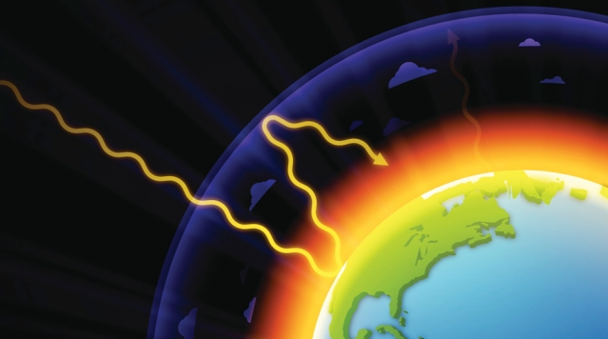
In 1896, a scientist discovered the greenhouse effect:
some gases in our atmosphere trap heat.
Notes:
“In 1896, a scientist discovered the greenhouse effect. Who’s heard of the greenhouse effect? Can anyone explain it?”
*Click*
“The greenhouse effect means that some gases in our atmosphere trap heat.”
[Image © source unknown. All rights reserved. This content is excluded from our Creative Commons license. For more information, see https://ocw.mit.edu/help/faq-fair-use/.]
Source: S. Arrhenius, “On the Influence of Carbonic Acid in the Air upon the Temperature of the Ground,” 1896.

Slide 11
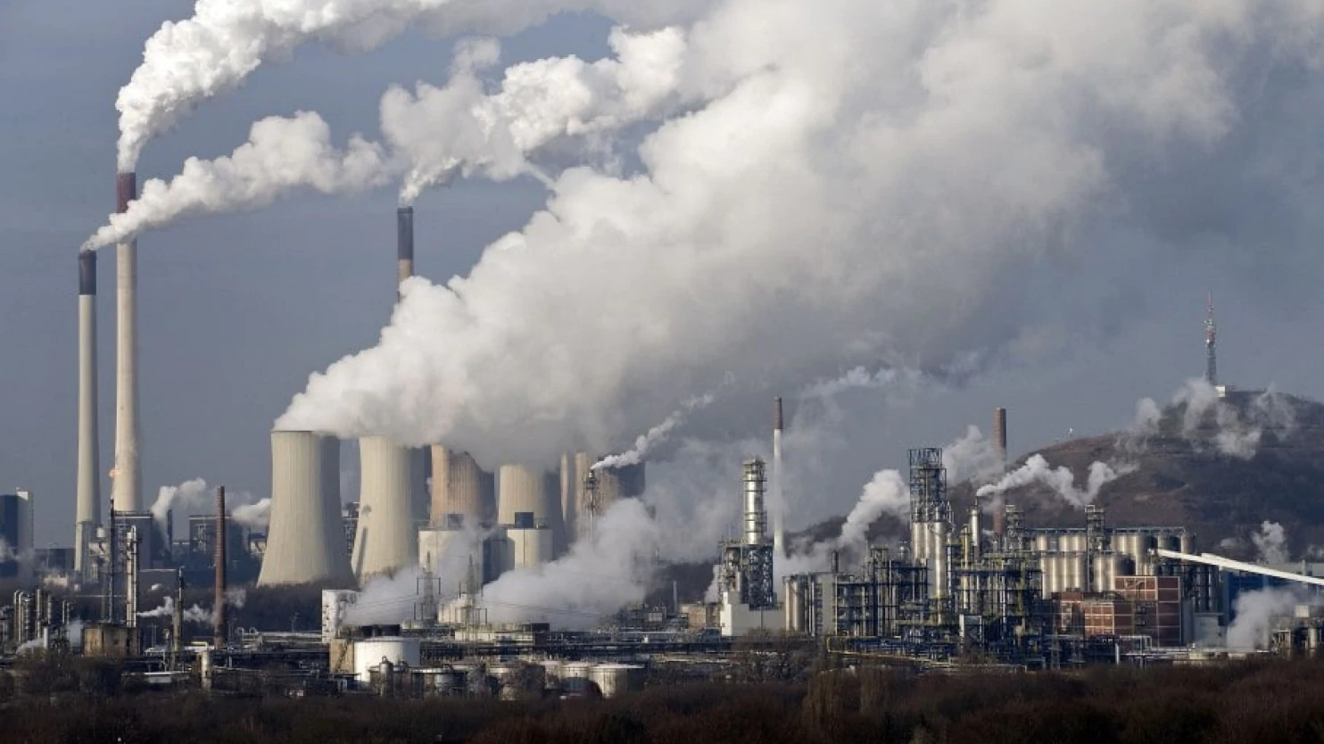
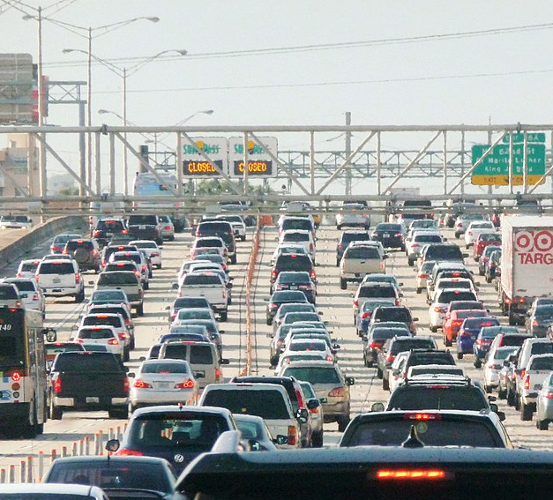
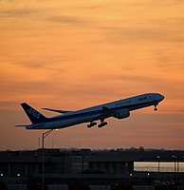
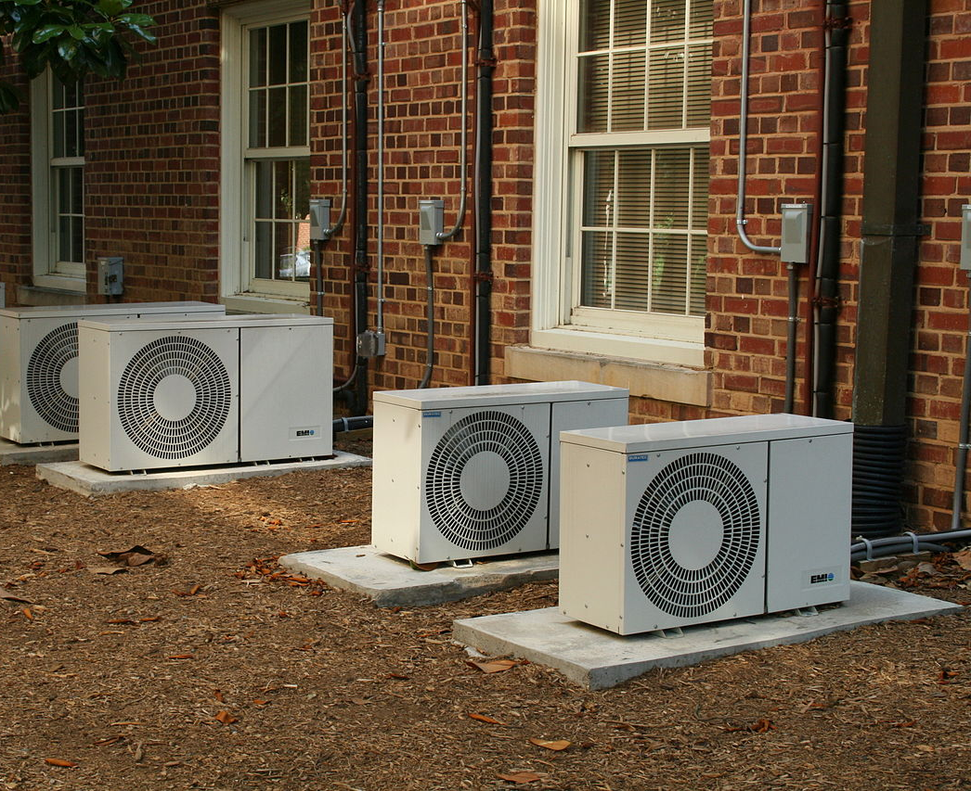
We emit these greenhouse gases by burning fossil fuels for transportation and electricity.
Driving
Flying
Air conditioning
Notes:
“We emit these greenhouse gases by burning fossil fuels for transportation and electricity. Things like” *click*
“Driving” *click*
“Flying” *click*
“And air conditioning” *click*
“All emit greenhouse gases.”
[Left image © Wikipedia editor B137. CC BY-SA 4.0. This content is excluded from our Creative Commons license. For more information, see https://ocw.mit.edu/help/faq-fair-use/. Center image © Quintin Soloviev. CC BY-SA 4.0. This content is excluded from our Creative Commons license. For more information, see https://ocw.mit.edu/help/faq-fair-use/. Right image courtesy of Pixabay. Background image © Associated Press. All rights reserved. This content is excluded from our Creative Commons license. For more information, see https://ocw.mit.edu/help/faq-fair-use/.]

Slide 12
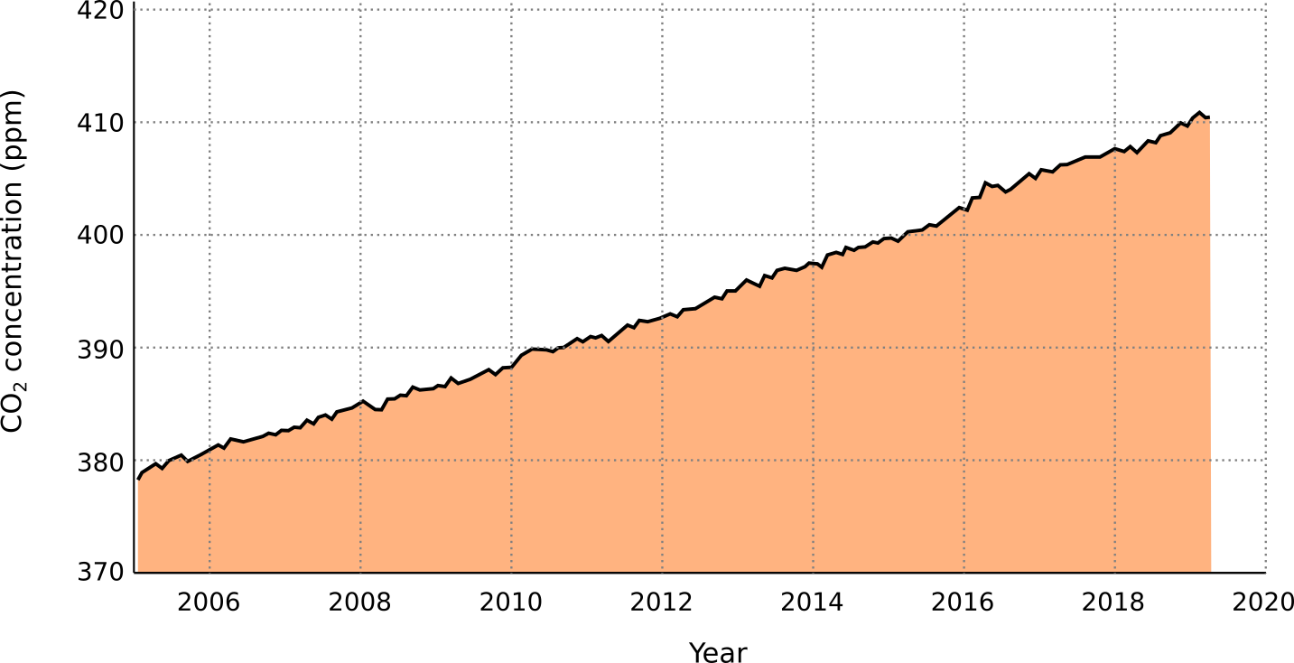
As we burn fossil fuels like oil, gas, and coal, greenhouse gas concentrations rise.
Since 2005
NOAA
Notes:
“As we burn fossil fuels like oil, gas, and coal, greenhouse gas concentrations rise.” *click*
“You can see here how carbon in the atmosphere – one of the main greenhouse gases – has increased steadily since 2005.”
Data source: Monthly measurements (average seasonal cycle removed).
Image source: https://climate.nasa.gov/embed/126/. [Public domain image courtesy of NASA, based on NOAA data.]

Slide 13
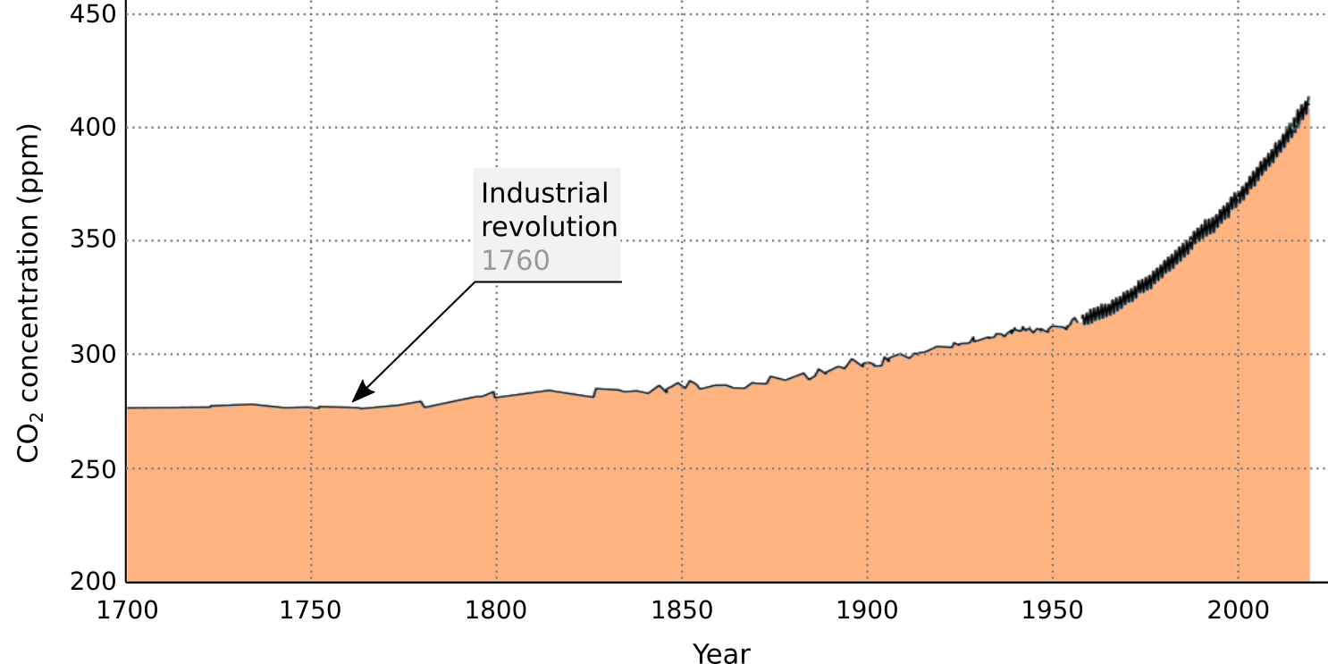
As we burn fossil fuels like oil, gas, and coal, greenhouse gas concentrations rise.
Since 1700
Scripps
Notes:
“Here’s the same data, but starting in 1700 – and you can see how shortly after the Industrial Revolution, carbon dioxide concentrations start to climb.”
Data source: Scripps Oceanographic Institute.

Slide 14
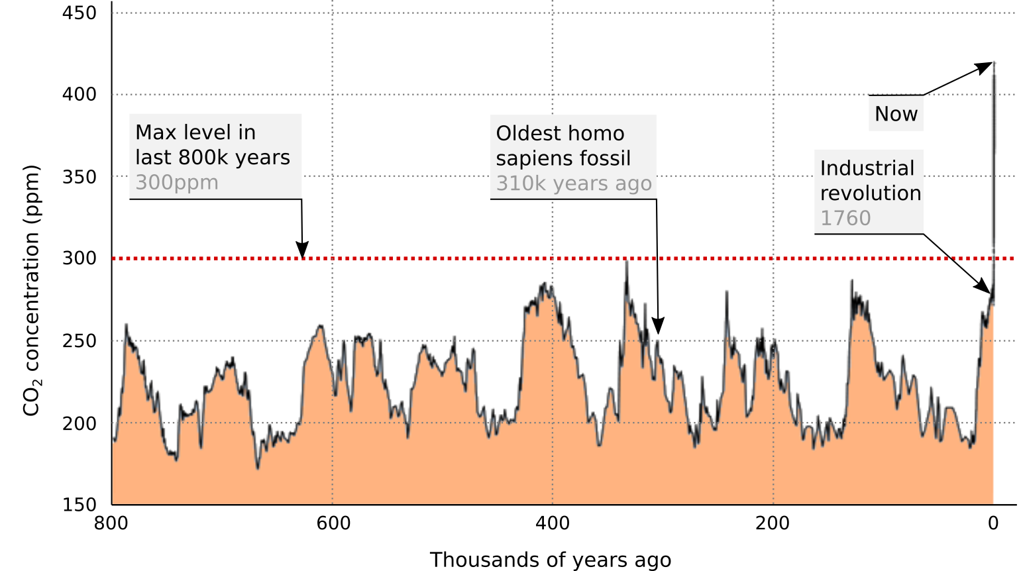
As we burn fossil fuels like oil, gas, and coal, greenhouse gas concentrations rise.
Last 800,000 years
Now
NOAA
Notes:
“Now here’s the data for the last 800,000 years. Its maximum for the last 800,000 years was 300 ppm,” *click*
“Homo sapiens – that’s us – appeared about 300,000 years ago,” *click*
“The Industrial revolution happened about 250 years ago, and” *click*
“Here’s carbon dioxide concentration today.” *click*
“Greenhouse gases have spiked since industrialization.”
Data source: Reconstruction from ice cores. Credit: NOAA
Image source: https://climate.nasa.gov/vital-signs/carbon-dioxide/
Graph courtesy of NASA, based on NOAA data

Slide 15
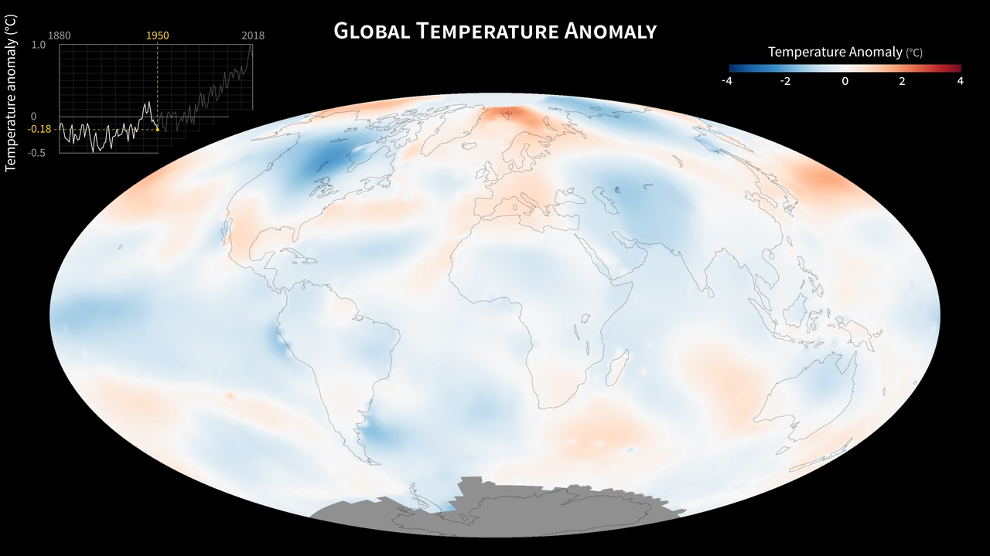
As humans emit more greenhouse gases, our atmosphere traps more heat, and the Earth warms.
0.82°C
(or, 1.5°F)
NASA
Notes:
“As humans emit more greenhouse gases, our atmosphere traps more heat and the Earth warms.” *click*
“You can see how in 1950, we start with red and blue equally balanced, but as the years go on, we see more, and more red, with the Earth getting hotter, and hotter, and hotter… We’ve now warmed the earth by 0.82 degrees Celsius.”
Public domain image courtesy of NASA's Goddard Space Flight Center, NASA Goddard Institute for Space Studies.
More info: http://svs.gsfc.nasa.gov/31028

Slide 16
I know what you’re thinking:
Who cares?
Notes:
“I know what you’re thinking.” *click*
“Who cares about 1.5 degrees Fahrenheit?”

Slide 17
The Truth
The Consequences
The Myths
The Future
Notes:
“That brings us from the Truth…” *click*

Slide 18
The Truth
The Consequences
The Myths
The Future
Notes:
“To the consequences.”

Slide 19
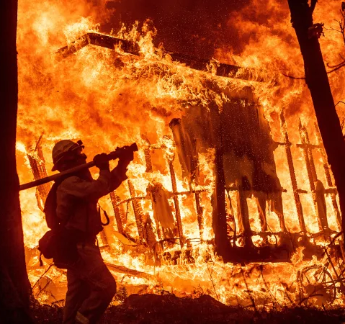
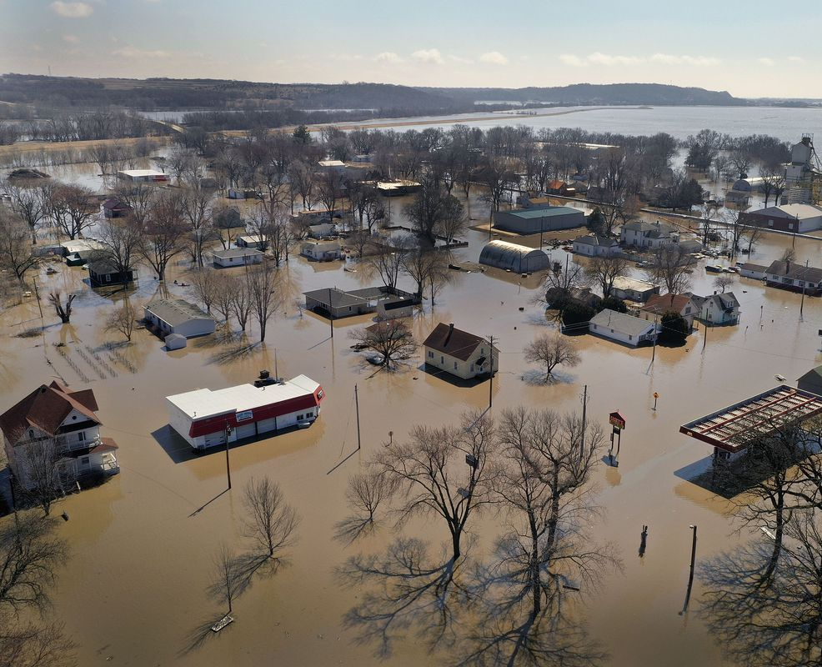
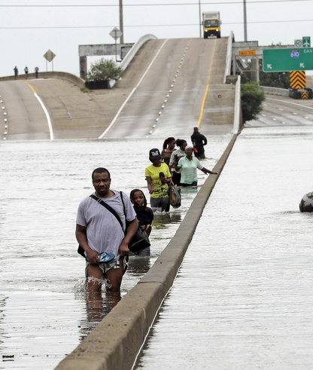
Climate change already affects us.
Wildfires in California
Flooding in the Midwest
Hurricanes on the East Coast
Notes:
“Climate change already affects us. Whether it’s” *click*
“Wildfires in California” *click*
“Flooding in the Midwest” *click*
“Or hurricanes on the East Coast, climate change affects you, me, and other Americans already.”
Left photo: © The Associated Press. All rights reserved. This content is excluded from our Creative Commons license. For more information, see https://ocw.mit.edu/help/faq-fair-use/. Center: © Scott Olson / Getty Images. All rights reserved. This content is excluded from our Creative Commons license. For more information, see https://ocw.mit.edu/help/faq-fair-use/. Right: © The Associated Press. All rights reserved. This content is excluded from our Creative Commons license. For more information, see https://ocw.mit.edu/help/faq-fair-use/.

Slide 20
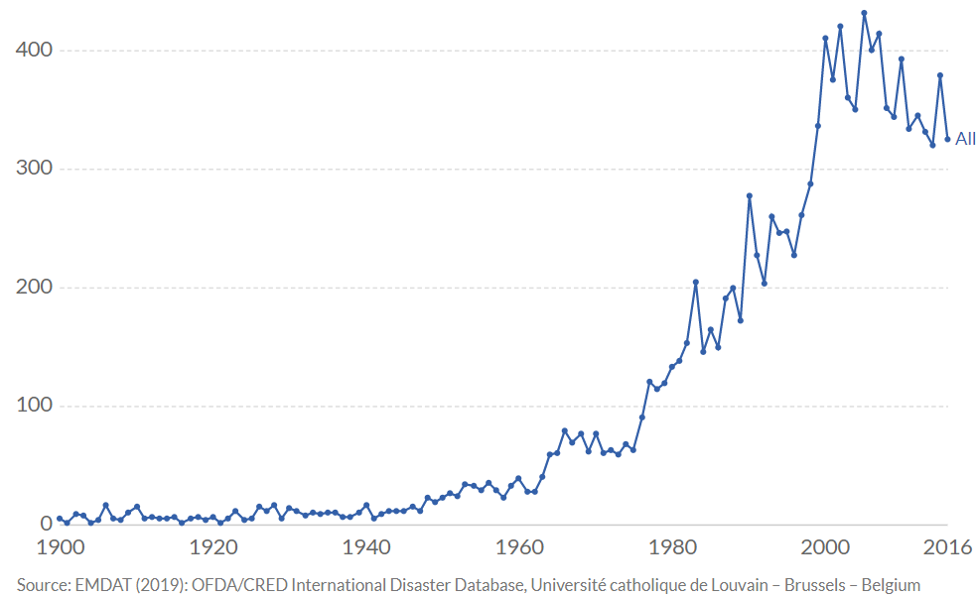
Heatwaves, floods, and other disasters are becoming more frequent.
Recorded natural disasters per year
EM-DAT Database
Notes:
“Heatwaves, floods, and other disasters are becoming more frequent.” *click*
“You can see here that the number of disasters has skyrocketed since 1980.”
Image source: https://ourworldindata.org/natural-disasters . Graph courtesy of Our World In Data.
Data source: EMDAT (2019) OFDA/CRED International Disaster Database, Universite Catholique de Louvain – Brussels – Belgium

Slide 21
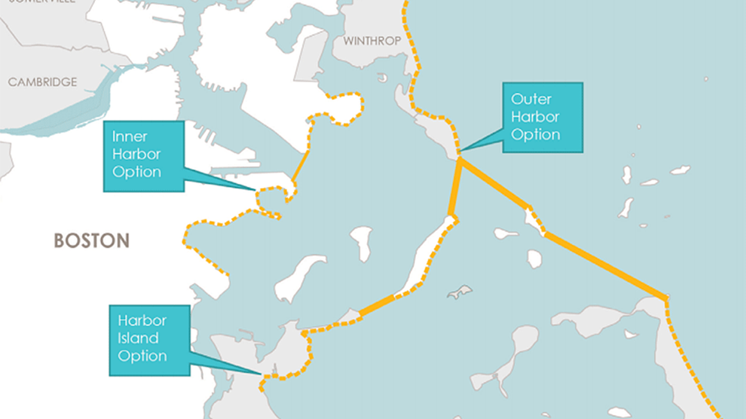
In Boston, the city is planning sea walls because of more intense and frequent flooding.
Notes:
Replace this slide with one that’s local to your audience.
Source: S. Rios, “A Barrier For Boston Harbor: UMass Team Studies Flood-Protection Plans,” WBUR News, 2017.
Image source: https://www.wbur.org/news/2017/09/06/boston-harbor-barrier-proposals
Originally from City of Boston’s Climate Ready report: https://www.boston.gov/sites/default/files/embed/2/20161207_climate_ready_boston_digital2.pdf

Slide 22
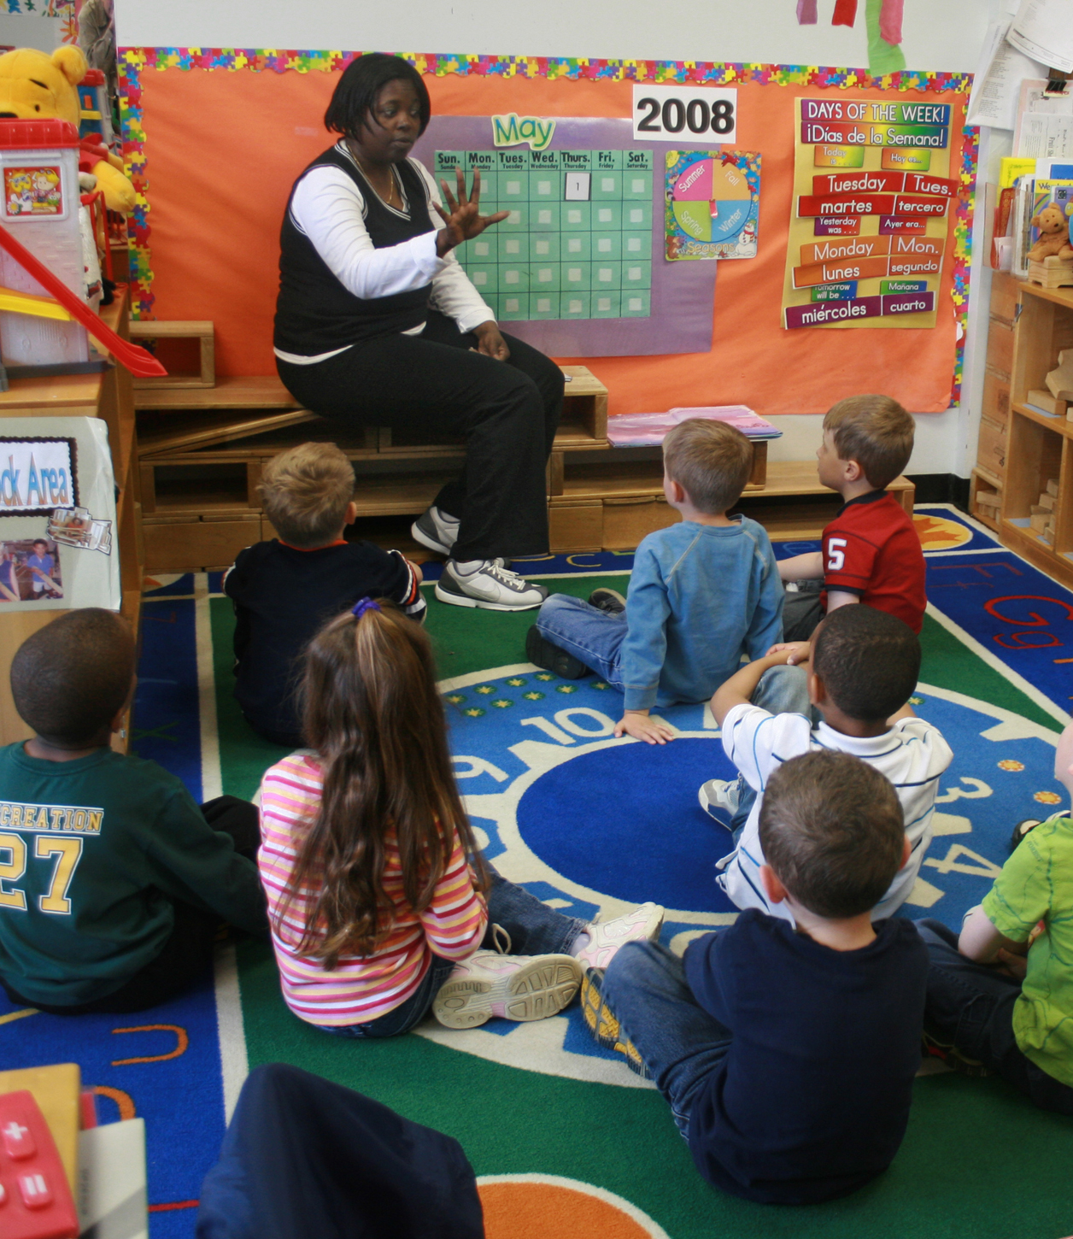
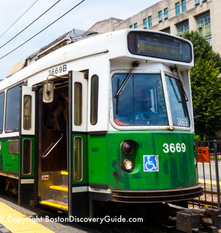

Cities must spend your parents’ tax money on climate adaptations instead of schools, transit, and hospitals.
Notes:
“Cities must spend your parents’ tax money on climate adaptations instead of school, transit, and hospitals.”
Left: image courtesy of woodleywonderworks on Wikipedia. Center: © Boston Discovery Guide. All rights reserved. This content is excluded from our Creative Commons license. For more information, see https://ocw.mit.edu/help/faq-fair-use/. Right: © Boston Magazine / Alex Lau. All rights reserved. This content is excluded from our Creative Commons license. For more information, see https://ocw.mit.edu/help/faq-fair-use/.

Slide 23
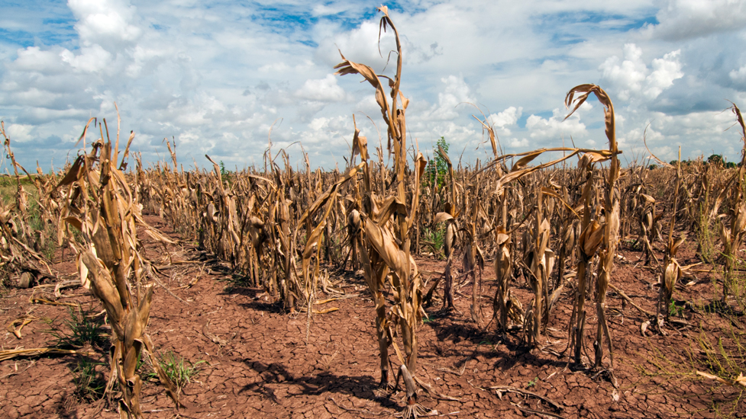
Unusual weather also affects food.
By 2030, a drought could double the price of corn.*
By stifling crop growth,
climate change limits food access.
*Even if you don’t eat corn, you might like chicken and fish, which are raised on corn feed. Or maybe you eat high fructose corn syrup in cereal or bread.
Notes:
“Unusual weather also affects food. By 2030, a single drought could double the price of corn.” *click*
“Now even if you don’t eat corn, you might like chicken and fish, which are raised on corn feed. Or maybe you eat high fructose corn syrup in cereal or bread. And of course, it’s not just corn. The point is” *click*
“By stifling crop growth, climate change limits food access.”
Image © Union of Concerned Scientists. All rights reserved. This content is excluded from our Creative Commons license. For more information, see https://ocw.mit.edu/help/faq-fair-use/.
Sources:
T. Carty, “Extreme Weather, Extreme Prices: The costs of feeding a warming world,” 2012. Oxfam.
T. Moss and L. V. J. Wholey, “Climate change linked to global rise in food prices,” Climate Change | Medill | Northwestern University. [Online].
More info:
https://nca2018.globalchange.gov/chapter/10/
Image Source: https://www.ucsusa.org/global-warming/science-and-impacts/impacts/causes-of-drought-climate-change-connection.html

Slide 24

Climate change also affects water. This woman migrated over 150 miles because of a drought.
Notes:
“In addition to food, climate change also affects water supplies.
A drought forced this woman’s family to move over 150 miles to find water.”
Image © National Geographic Society. All rights reserved. This content is excluded from our Creative Commons license. For more information, see https://ocw.mit.edu/help/faq-fair-use/.

Slide 25
By 2050 the UN projects
200 million
environmental migrants.*
*People who leave their homes because of changes in the environment.
Notes:
“By 2050 the UN projects 200 million environmental migrants.” *click*
“That’s people who leave their homes because of changes in the environment.”
Source: “Climate Migrants Might Reach One Billion by 2050,” United Nations University, 2017. [Online].
Image source: https://www.brookings.edu/research/the-climate-crisis-migration-and-refugees/
Image © The Brookings Institution. All rights reserved. This content is excluded from our Creative Commons license. For more information, see https://ocw.mit.edu/help/faq-fair-use/.

Slide 26
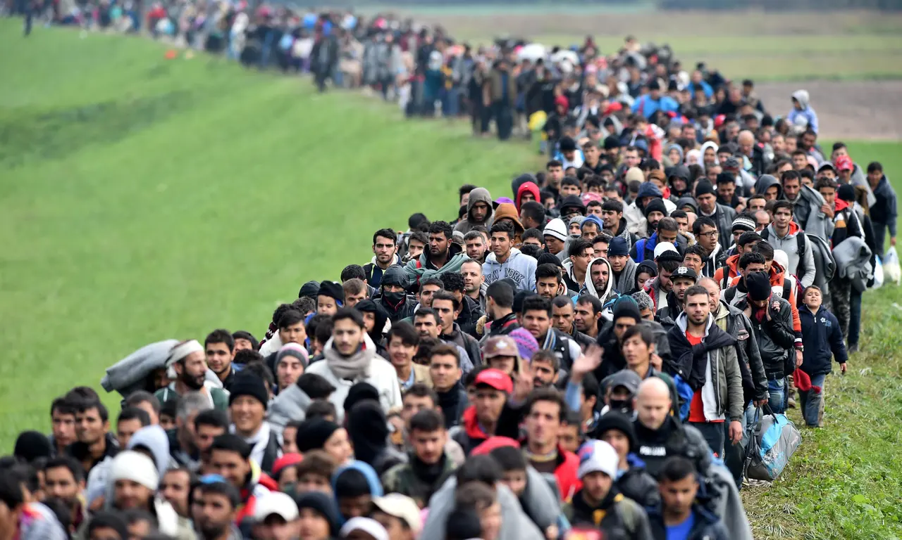
In recent migrant crises, thousands of refugees created turmoil in Europe and America.
What happens when millions of people
move North in search of food, water, and safety?
Notes:
“Now my question to you is this: In recent migrant crises, thousands of refugees created turmoil in Europe and America.” *click*
“What happens when millions move North in search of food, water, and safety?”
Image source: https://www.theguardian.com/commentisfree/video/2016/may/18/migration-crisis-get-rational-video © The Guardian. All rights reserved. This content is excluded from our Creative Commons license. For more information, see https://ocw.mit.edu/help/faq-fair-use/.

Slide 27

The US military refers to climate change as a “threat multiplier,” because it makes every bad situation worse.*
* The Pentagon has released reports about climate change under both Democratic and Republican administrations.
Notes:
Even the US military refers to climate change as a “threat multiplier,” because it makes every bad situation worse.
Sources: “2014 Climate Change Adaptation Roadmap,” 2014. US Department of Defense.
“Report on Effects of a Changing Climate,” 2019. US Department of Defense.
Department of Defense seal is in the public domain. No affiliation with the Department of Defense is implied.

Slide 28
These problems are not just in the future.
They’re happening right now.
Notes:
“These problems aren’t just in the future.” *click*
“They’re happening right now.”

Slide 29
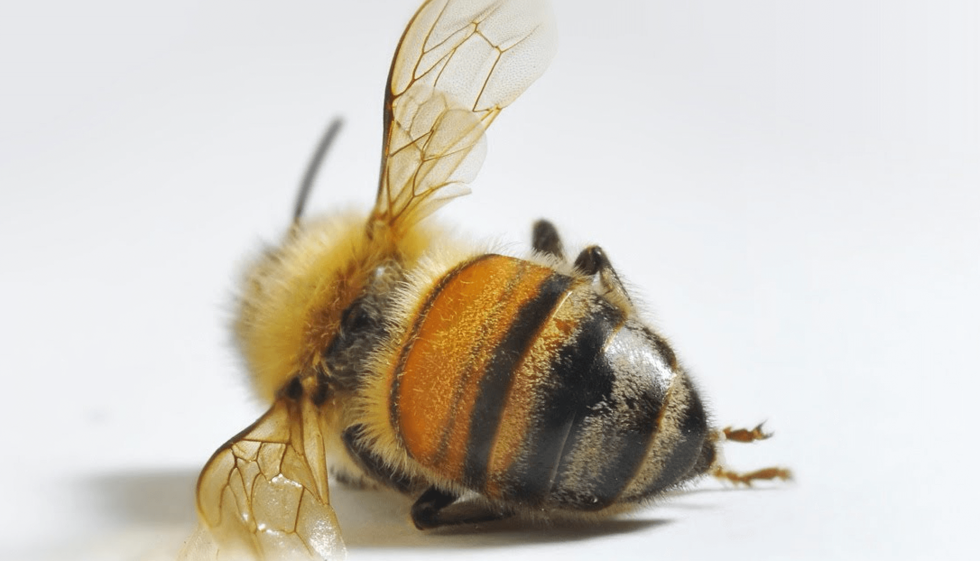
The current species extinction rate is 1,000 times higher than normal.
United Nations
Notes:
“Here’s another example: the current species extinction rate is 1,000 times higher than natural background rates.
And, by the way, if pollinators die, so do we – there won’t be any crops left for us to eat.”
Source: E. Chivian, A. Bernstein, Secretariat of the Convention on Biological Diversity., United Nations Development Programme., United Nations Environment Programme., and IUCN--The World Conservation Union., Sustaining life : how human health depends on biodiversity. Oxford University Press, 2008.
Bee extinction and climate change: https://besjournals.onlinelibrary.wiley.com/doi/full/10.1111/1365-2435.13151
More info:
Image: https://geneticliteracyproject.org/2016/05/18/science-news-release-media-miss-bee-extinction-reports/ © Genetic Literacy Project. All rights reserved. This content is excluded from our Creative Commons license. For more information, see https://ocw.mit.edu/help/faq-fair-use/.

Slide 30

We’re on track for one million species extinctions.
Here’s what one looks like:
We’re on track for one million species extinctions.
Here’s what one of those looks like:
Notes:
“According to the UN, we’re on track for one million species extinctions. Here’s what just one of those looks like.” *click*
Source: H. T. Ngo et al., “Summary for policymakers of the global assessment report on biodiversity and ecosystem services,” 2019.
More info: UN IPBES
Video link: https://www.youtube.com/watch?v=x3gRU_SAN18

Slide 31
We could live more sustainably.
So why don’t we?
Notes:
“We could live more sustainably.” *click*
“So why don’t we?”

Slide 32
The Truth
The Consequences
The Myths
The Future
Notes:
“Now we move from the consequences…” *click*

Slide 33
The Truth
The Consequences
The Myths
The Future
Notes:
“To the myths.”

Slide 34
We’ll set the stage with a game called Commons.
Form groups of 5 people, sit in a circle, and count off from 1 to 5.
Setup: Start your pond with 20 fish. This is your pond’s carrying capacity.
Goal: At the end of the game, the winner is the person in the room with the most fish. You win as an individual – not as a group.
Gameplay: 4 Rounds
Each round, every person in your group will take between 1 and 4 fish.
After each round, your pond will be restocked by doubling the number of fish without exceeding 20.
  4 fish becomes 8.
  9 fish becomes 18.
  10 fish or more brings the pond back to 20 (the carrying capacity).
(Don’t eat the goldfish yet. If you have allergies, don’t eat the goldfish at all.)
Notes:
“And to set the stage, let’s a game called Commons.”
Click and read through the rules of Commons.
“Any questions?”
Address groups with fewer/more than 5 people: “Your carrying capacity will actually be 4 times the number of people in your group” – and explain the re-stocking rule for them.
Inspired by Harvest, from the Systems Thinking Playbook.
L. B. Sweeney, D. Meadows, and G. M. Mehers, The Systems Thinking Playbook for Climate Change: A Toolkit for Interactive Learning. Deutsche Gesellschaft für Internationale Zusammenarbeit, 2011.

Slide 35
You have thirty seconds to discuss strategy.
Take 1 to 4 fish.
Restock the pond.
Repeat four times.
At the end of the game, the winner is the individual in the room with the most fish.

Slide 36
Round one.
Take turns going clockwise, starting with player #3.
You have 60 seconds.
Each person in your group takes between 1 and 4 fish.

Slide 37
Restock your pond.
You have thirty seconds.
Double the number of fish in your pond (but don’t exceed 20).
  4 fish becomes 8;
  9 fish becomes 18.
  10 fish or more brings the pond back to 20 (the carrying capacity).

Slide 38
Round two.
Take turns going clockwise, starting with player #2.
You have 60 seconds.
Each person in your group takes between 1 and 4 fish.

Slide 39
Restock your pond.
You have thirty seconds.
Double the number of fish in your pond (but don’t exceed 20).
  4 fish becomes 8;
  9 fish becomes 18.
  10 fish or more brings the pond back to 20 (the carrying capacity).

Slide 40
Round three.
Take turns going clockwise, starting with player #4.
You have 60 seconds.
Each person in your group takes between 1 and 4 fish.

Slide 41
Restock your pond.
You have thirty seconds.
Double the number of fish in your pond (but don’t exceed 20).
  4 fish becomes 8;
  9 fish becomes 18.
  10 fish or more brings the pond back to 20 (the carrying capacity).

Slide 42
Final round.
Take turns going clockwise, starting with player #3.
You have 60 seconds.
Each person in your group takes between 1 and 4 fish.

Slide 43
Let’s do one last round, just for fun.
Notes:
“Let’s do one last round, just for fun.”

Slide 44
Restock your pond.
You have thirty seconds.
Double the number of fish in your pond (but don’t exceed 20).
  4 fish becomes 8;
  9 fish becomes 18.
  10 fish or more brings the pond back to 20 (the carrying capacity).

Slide 45
Final round. For real this time.
Take turns going clockwise, starting with player #1.
You have 60 seconds.
Each person in your group takes between 1 and 4 fish.

Slide 46
So who won?
Notes:
“So who won? Raise your hand if you got more than 10 fish. More than 12? More than 14? …”
“Round of applause for the winner, everyone!”

Slide 47
Why was Commons hard?
If everyone acts in their own interest, the pond dies.
Notes:
“Why was Commons hard?”
Allow for discussion time.
“So here’s the main problem: if everyone acts in their own interest, the pond dies.”

Slide 48
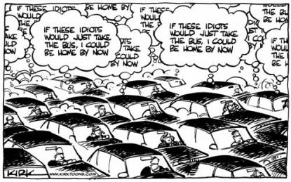
This is called the tragedy of the commons: when anyone can access a limited resource, it runs out.
Notes:
“This is called the tragedy of the commons: when anyone can access a limited resource, it runs out. *click*
Traffic is another great example… Everyone with a car can access a road, so soon enough, space runs it, and everyone ends up thinking, ‘If these idiots would just take the bus, I could be home by now.’”
Cartoon © source unknown. All rights reserved. This content is excluded from our Creative Commons license. For more information, see https://ocw.mit.edu/help/faq-fair-use/.

Slide 49
What are real-life examples of commons?
Think: limited resources that anyone can access.
Notes:
“Can anyone name other real-life examples of commons? Remember, they’re limited resources that anyone can access.”
Allow discussion to proceed until someone says Earth. Then *click*
Or if no one brings up Earth, bring it up yourself: “What about Earth? It’s a limited resource and we all can access it.” *click*
Image source: https://visibleearth.nasa.gov/view.php?id=57723 This image is in the public domain.

Slide 50
How do we solve commons problems?
Collective action: we set rules.
Notes:
“How do we solve commons problems? Either in the game or in real-life.”
Allow discussion to proceed
“So these suggestions have something in common: they all require collective action. In other words, we have to set rules for everyone.”

Slide 51
Setting rules for everyone is called politics.
Notes:
“Setting rules for everyone is called politics.”
Repeat this; it’s important.
Image © Guillermo Descalzi. All rights reserved. This content is excluded from our Creative Commons license. For more information, see https://ocw.mit.edu/help/faq-fair-use/.

Slide 52
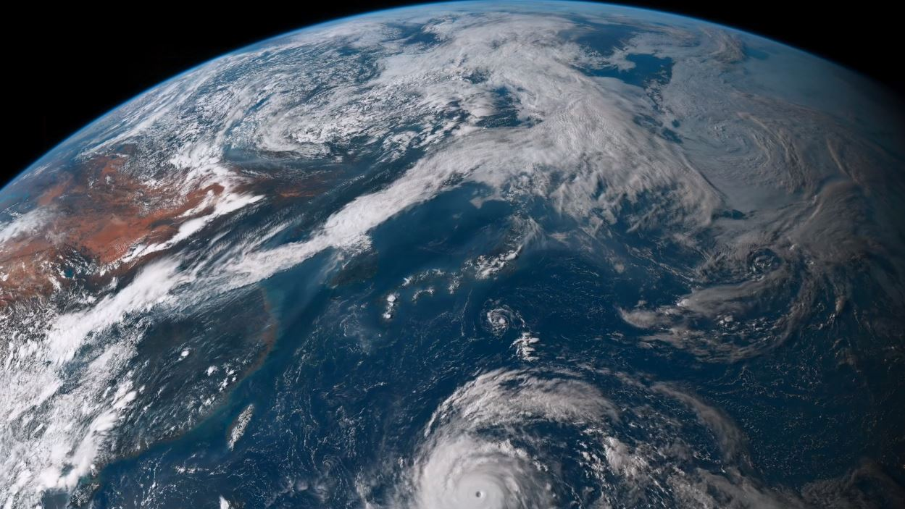
Protecting the most important commons, an inhabitable Earth, is political: we need rules.
Notes:
“Protecting the most important commons, an inhabitable Earth, is political: we need rules.”
Public domain image courtesy of NASA.

Slide 53
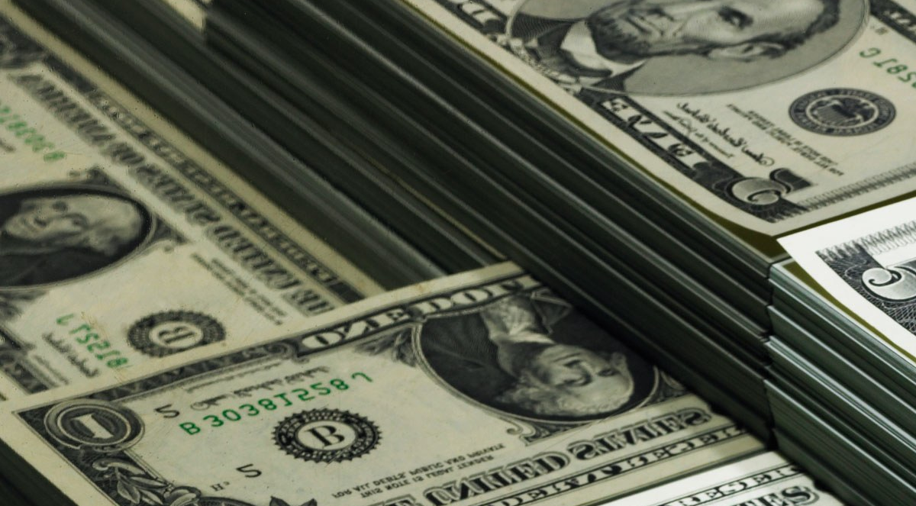
But rules cost money. For example:
:
“If I can’t sell my products, because I emit carbon to make them… I lose money!”
Notes:
“But rules cost money.” *click*
“If I can’t sell my products, because I emit carbon to make them… I lose money!”
Image © source unknown. All rights reserved. This content is excluded from our Creative Commons license. For more information, see https://ocw.mit.edu/help/faq-fair-use/.

Slide 54
So now we can answer the question…
Why haven’t we done anything?
Notes:
“So now we can answer the question, ‘Why haven’t we done anything?’”

Slide 55
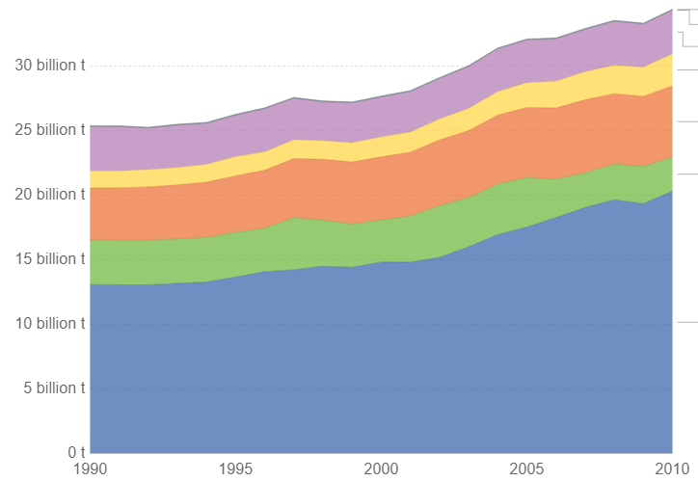
No one wants rules limiting carbon. But especially not fossil fuel groups, who emit more than anyone.
Carbon dioxide emissions by sector
Residential & commercial
Industry
Transportation
Agriculture and land use
Energy
(oil, gas, and coal)
UN FAO
Notes:
“No one wants rules limiting carbon. But especially not fossil fuel companies, who emit more than anyone.”
*click*
“We can see here how different sectors emit carbon dioxide: residential and commercial, industry, transportation, agriculture… but the biggest one by far is” *click*
“Energy. Oil, gas, and coal – aka fossil fuels – emit more than all other sectors combined.”
Transition: “Fossil fuels have been useful, and they enable our modern lifestyles…” *click*
Data source: UN Food and Agricultural Organization
Image source: https://ourworldindata.org/grapher/greenhouse-gas-emissions-by-sector . Graph courtesy of Our World In Data.

Slide 56
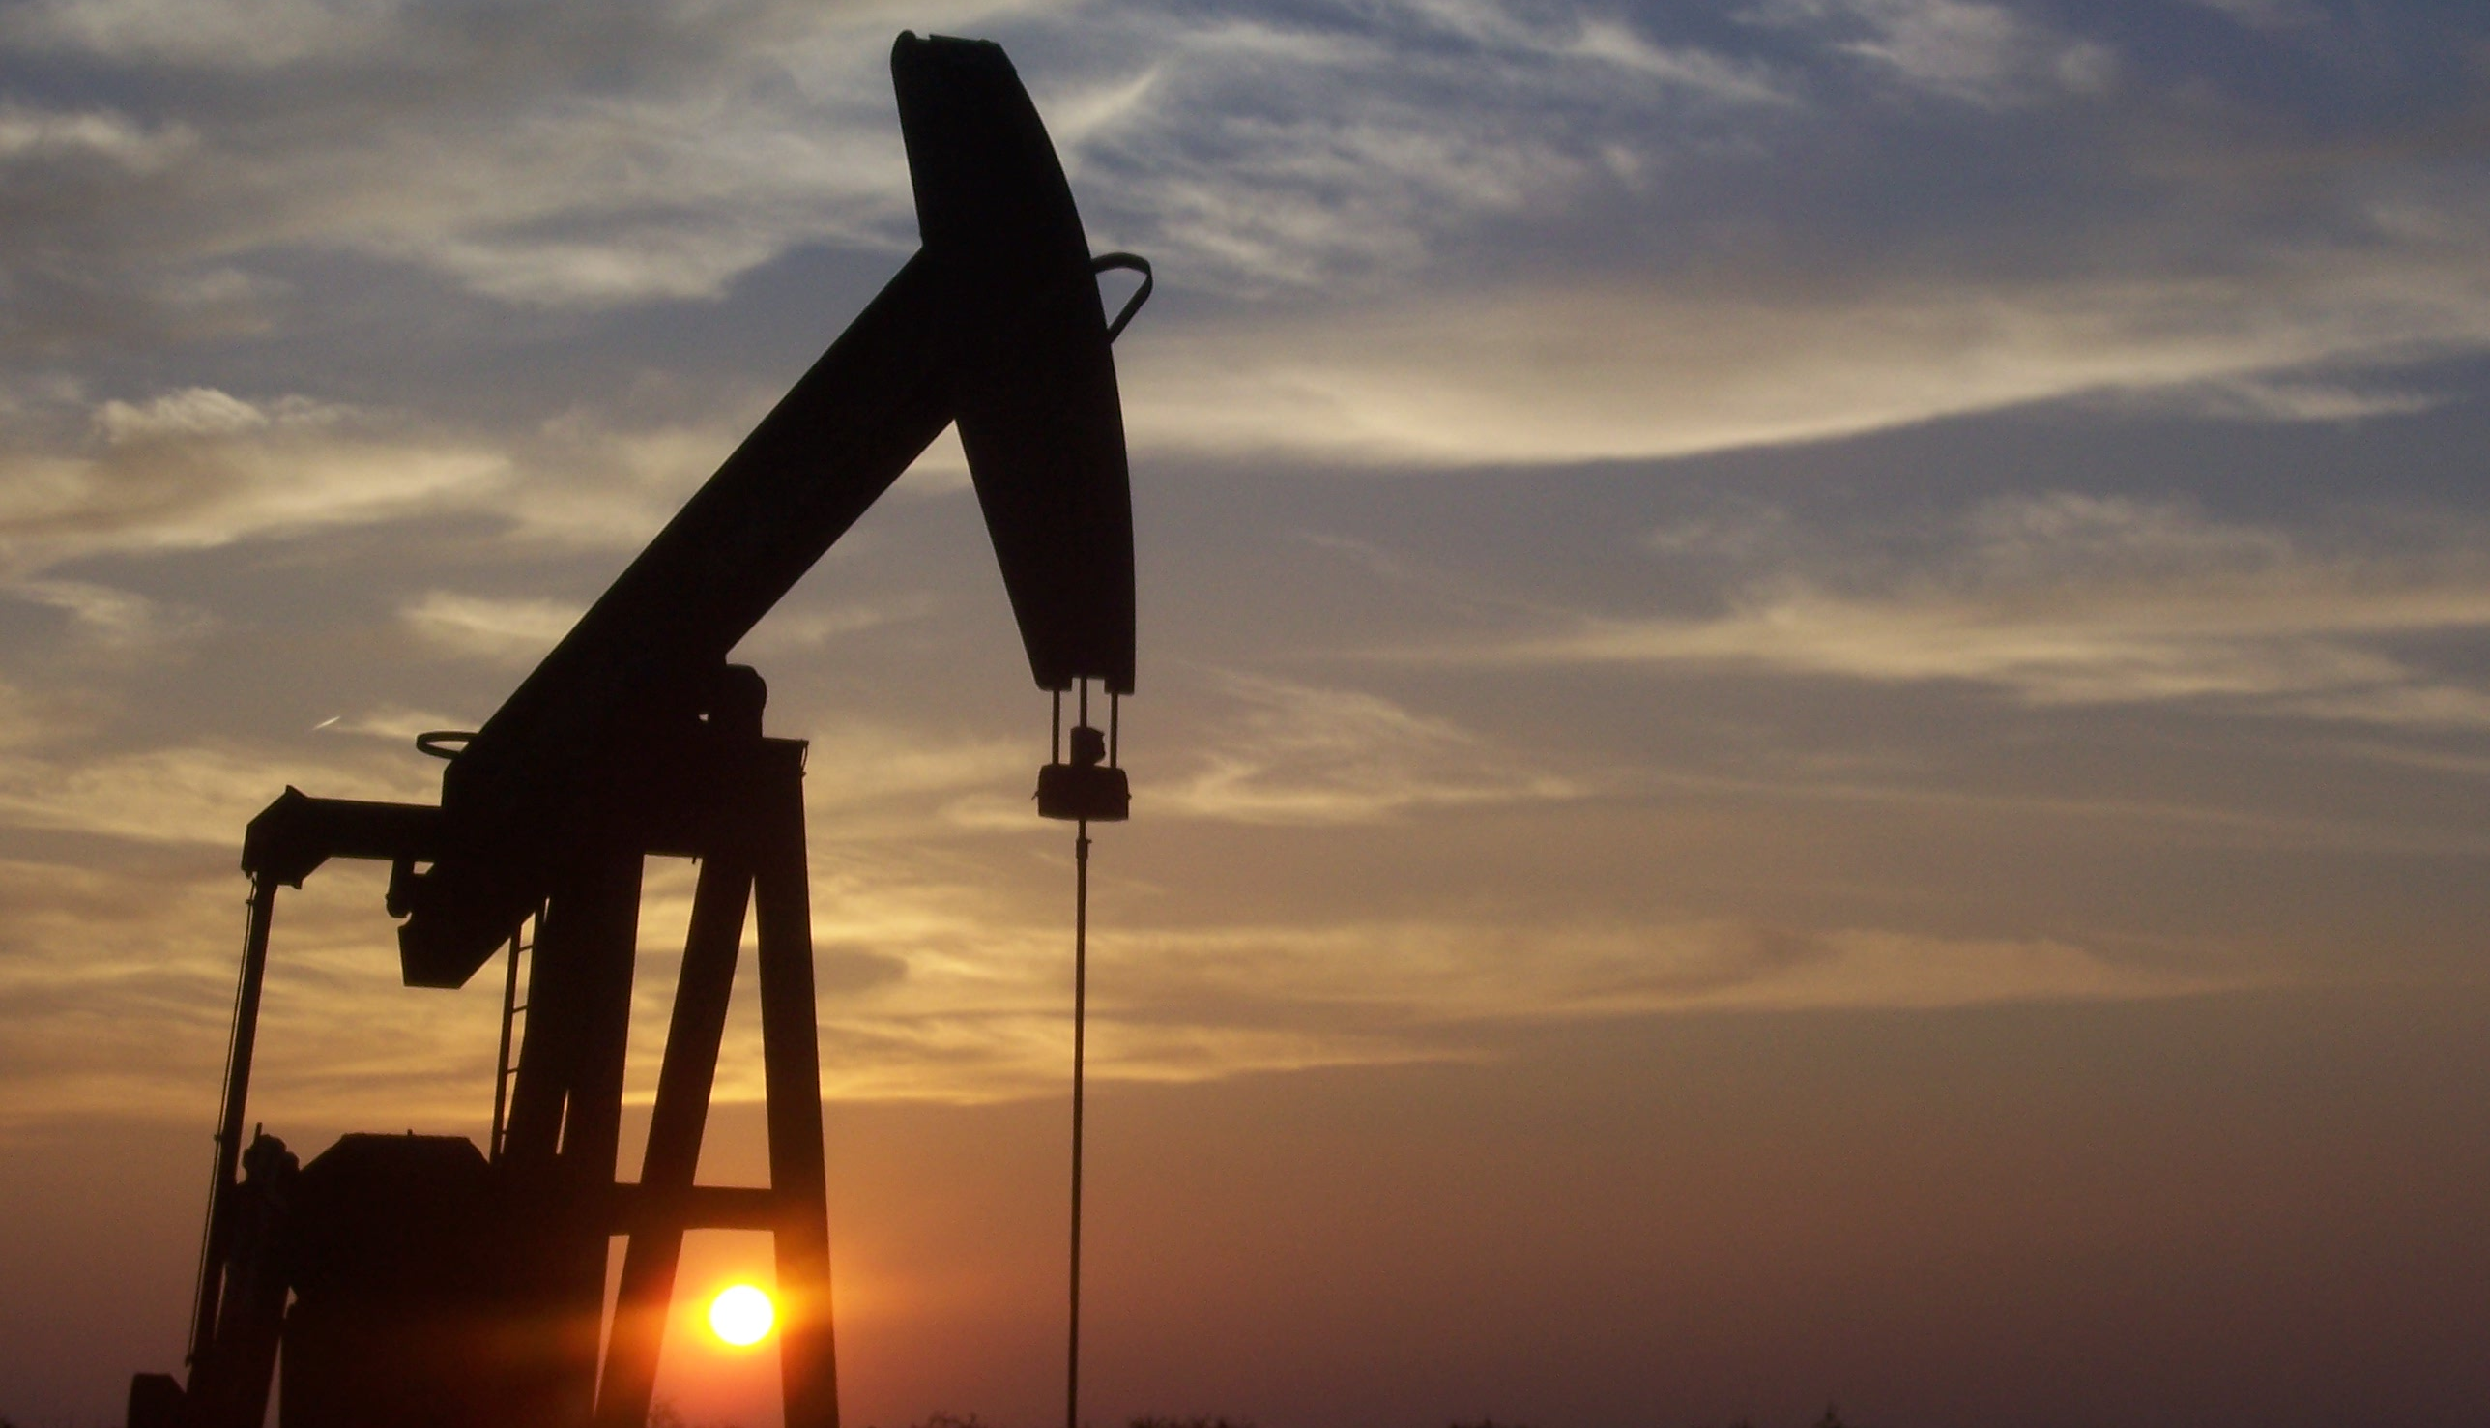
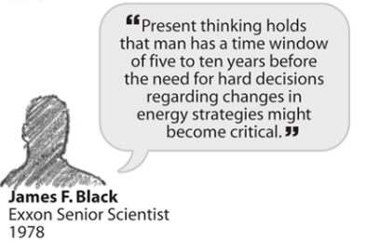
The fossil fuel industry has known about climate change for decades.
Inside Climate News
Notes:
“But the fossil fuel industry has known about climate change for decades.” *click*
“In 1978 – forty years ago – Exxon’s senior scientist said, “Present thinking holds that man has a time window of five to ten years before the need for hard decisions regarding changes in energy strategies become critical.”
“In other words, we have 5 to 10 years to figure out new ways of getting energy. He said that 40 years ago!”
Source: N. Oreskes and E. M. Conway, Merchants of Doubt, 1st ed. New York: Bloomsbury Press, 2010.
Image sources:
https://insideclimatenews.org/content/exxon-science-vs-misinformation
https://en.wikipedia.org/wiki/Oil_well

Slide 57
But fossil fuel companies spread climate myths to the public – including schools.
Sources
Inside Climate News
NASA
Desmog Blog
PBS
The Guardian
Notes:
“But fossil fuel companies spread myths to the public, including through schools.” *click*
[Pause after the video is done so students can see sources.]
Video link: https://www.youtube.com/watch?v=HXoAz6jNEG8

Slide 58
558 million dollars
Brulle, 2014
From 2003 to 2010, Koch Family Foundations and other fossil fuel groups gave
to climate denial organizations.*
*I wish I could share more financial data, but these groups are secretive and hard to study.
Notes:
“From 2003 to 2010, Koch Family Foundations and other fossil fuel groups gave 558 million dollars to climate denial organizations.” *click*
“And I wish I could share more financial data with you, but these groups are very secretive and hard to study.”
Source:
R. J. Brulle, “Institutionalizing delay: foundation funding and the creation of U.S. climate change counter-movement organizations,” Clim. Change, vol. 122, no. 4, pp. 681–694, Feb. 2014.

Slide 59

Fossil fuel companies know rules will hurt profits, so they spread myths about climate change.
Notes:
“Fossil fuel companies know that rules will hurt their profits, so they spread myths about climate change.”
Image source: https://www.needpix.com/photo/1484678/smoke-fumes-white-blur-light-wisp-vapour

Slide 60
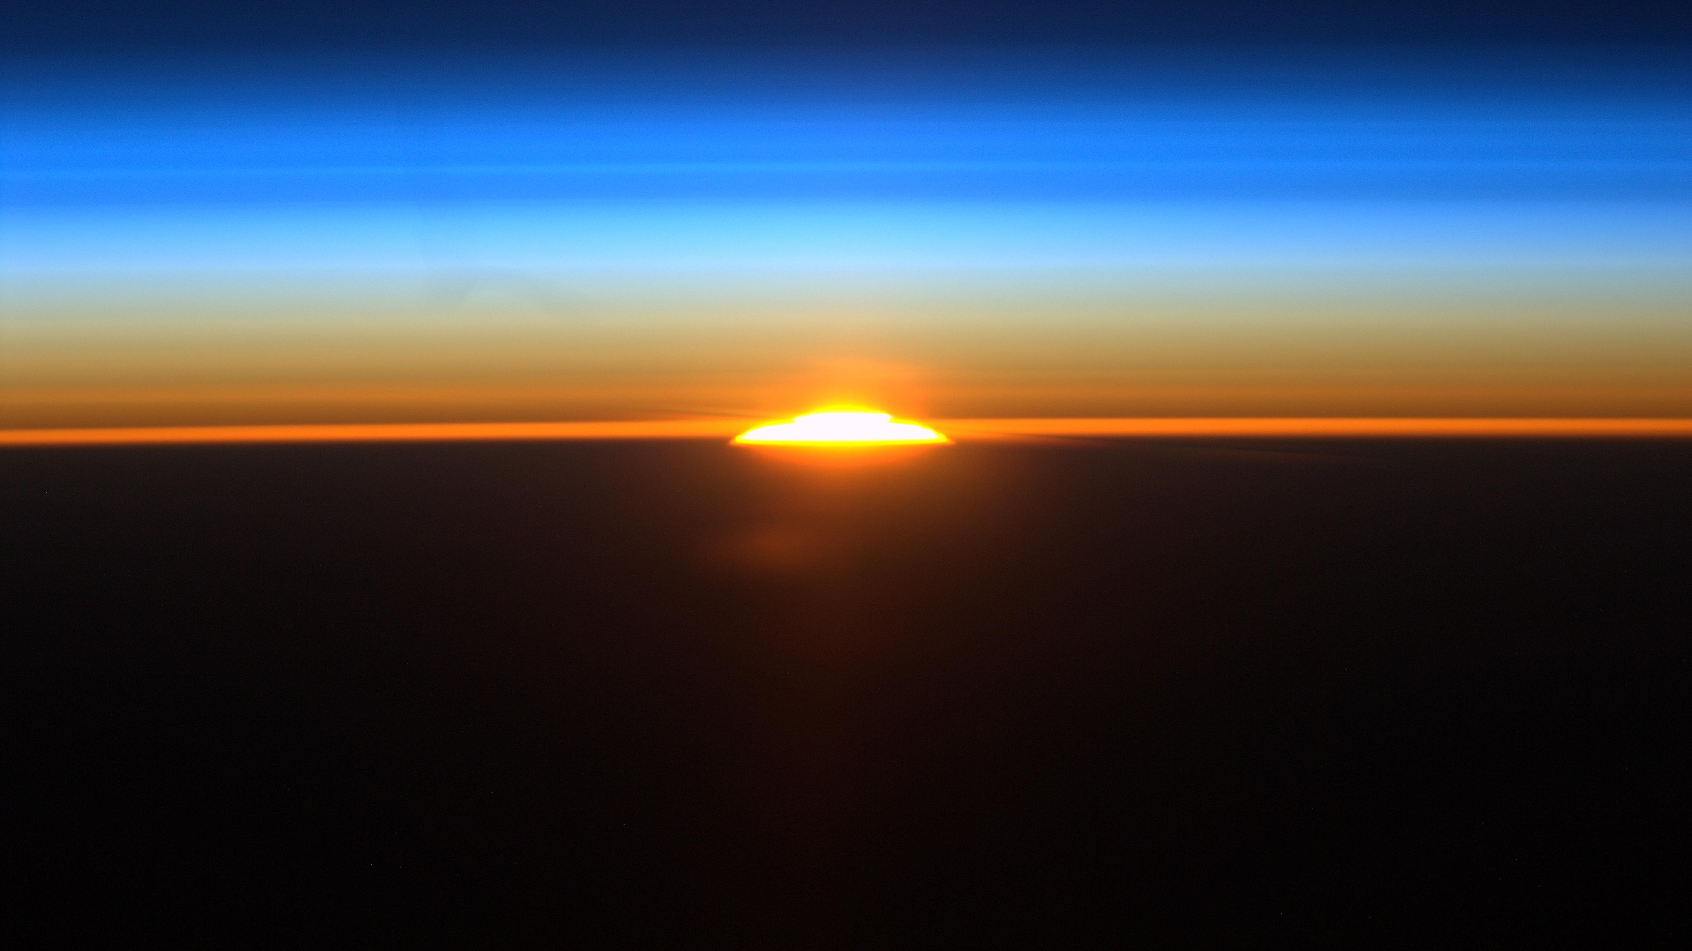
But now you know the truth.
Notes:
“But now you know the truth.”
Image source: https://www.nasa.gov/multimedia/imagegallery/image_feature_2047.html

Slide 61
Climate change is real.
It’s happening because of us.
It already affects you.
It will only get worse.
We haven’t done anything, because fossil fuel companies have lied to us for decades.

Slide 62
The Truth
The Consequences
The Myths
The Future
Notes:
“That leaves us with one last section…” *click*

Slide 63
The Truth
The Consequences
The Myths
The Future
Notes:
“How do we shape our future?”

Slide 64
Notes:
Video link: https://www.youtube.com/watch?v=TL2swGjau8w

Slide 65
We Need to Talk.
Notes:
“We need to talk. We need to talk loudly and often.”
“And I know talking doesn’t seem like it’s enough, given what I’ve shared, but…” *click*

Slide 66
Words give life to ideas. Ideas lead to change.
Your words matter.
Notes:
“Words give life to ideas, and ideas lead to change.”
“Your words matter.”
[free image from Pixabay]

Slide 67
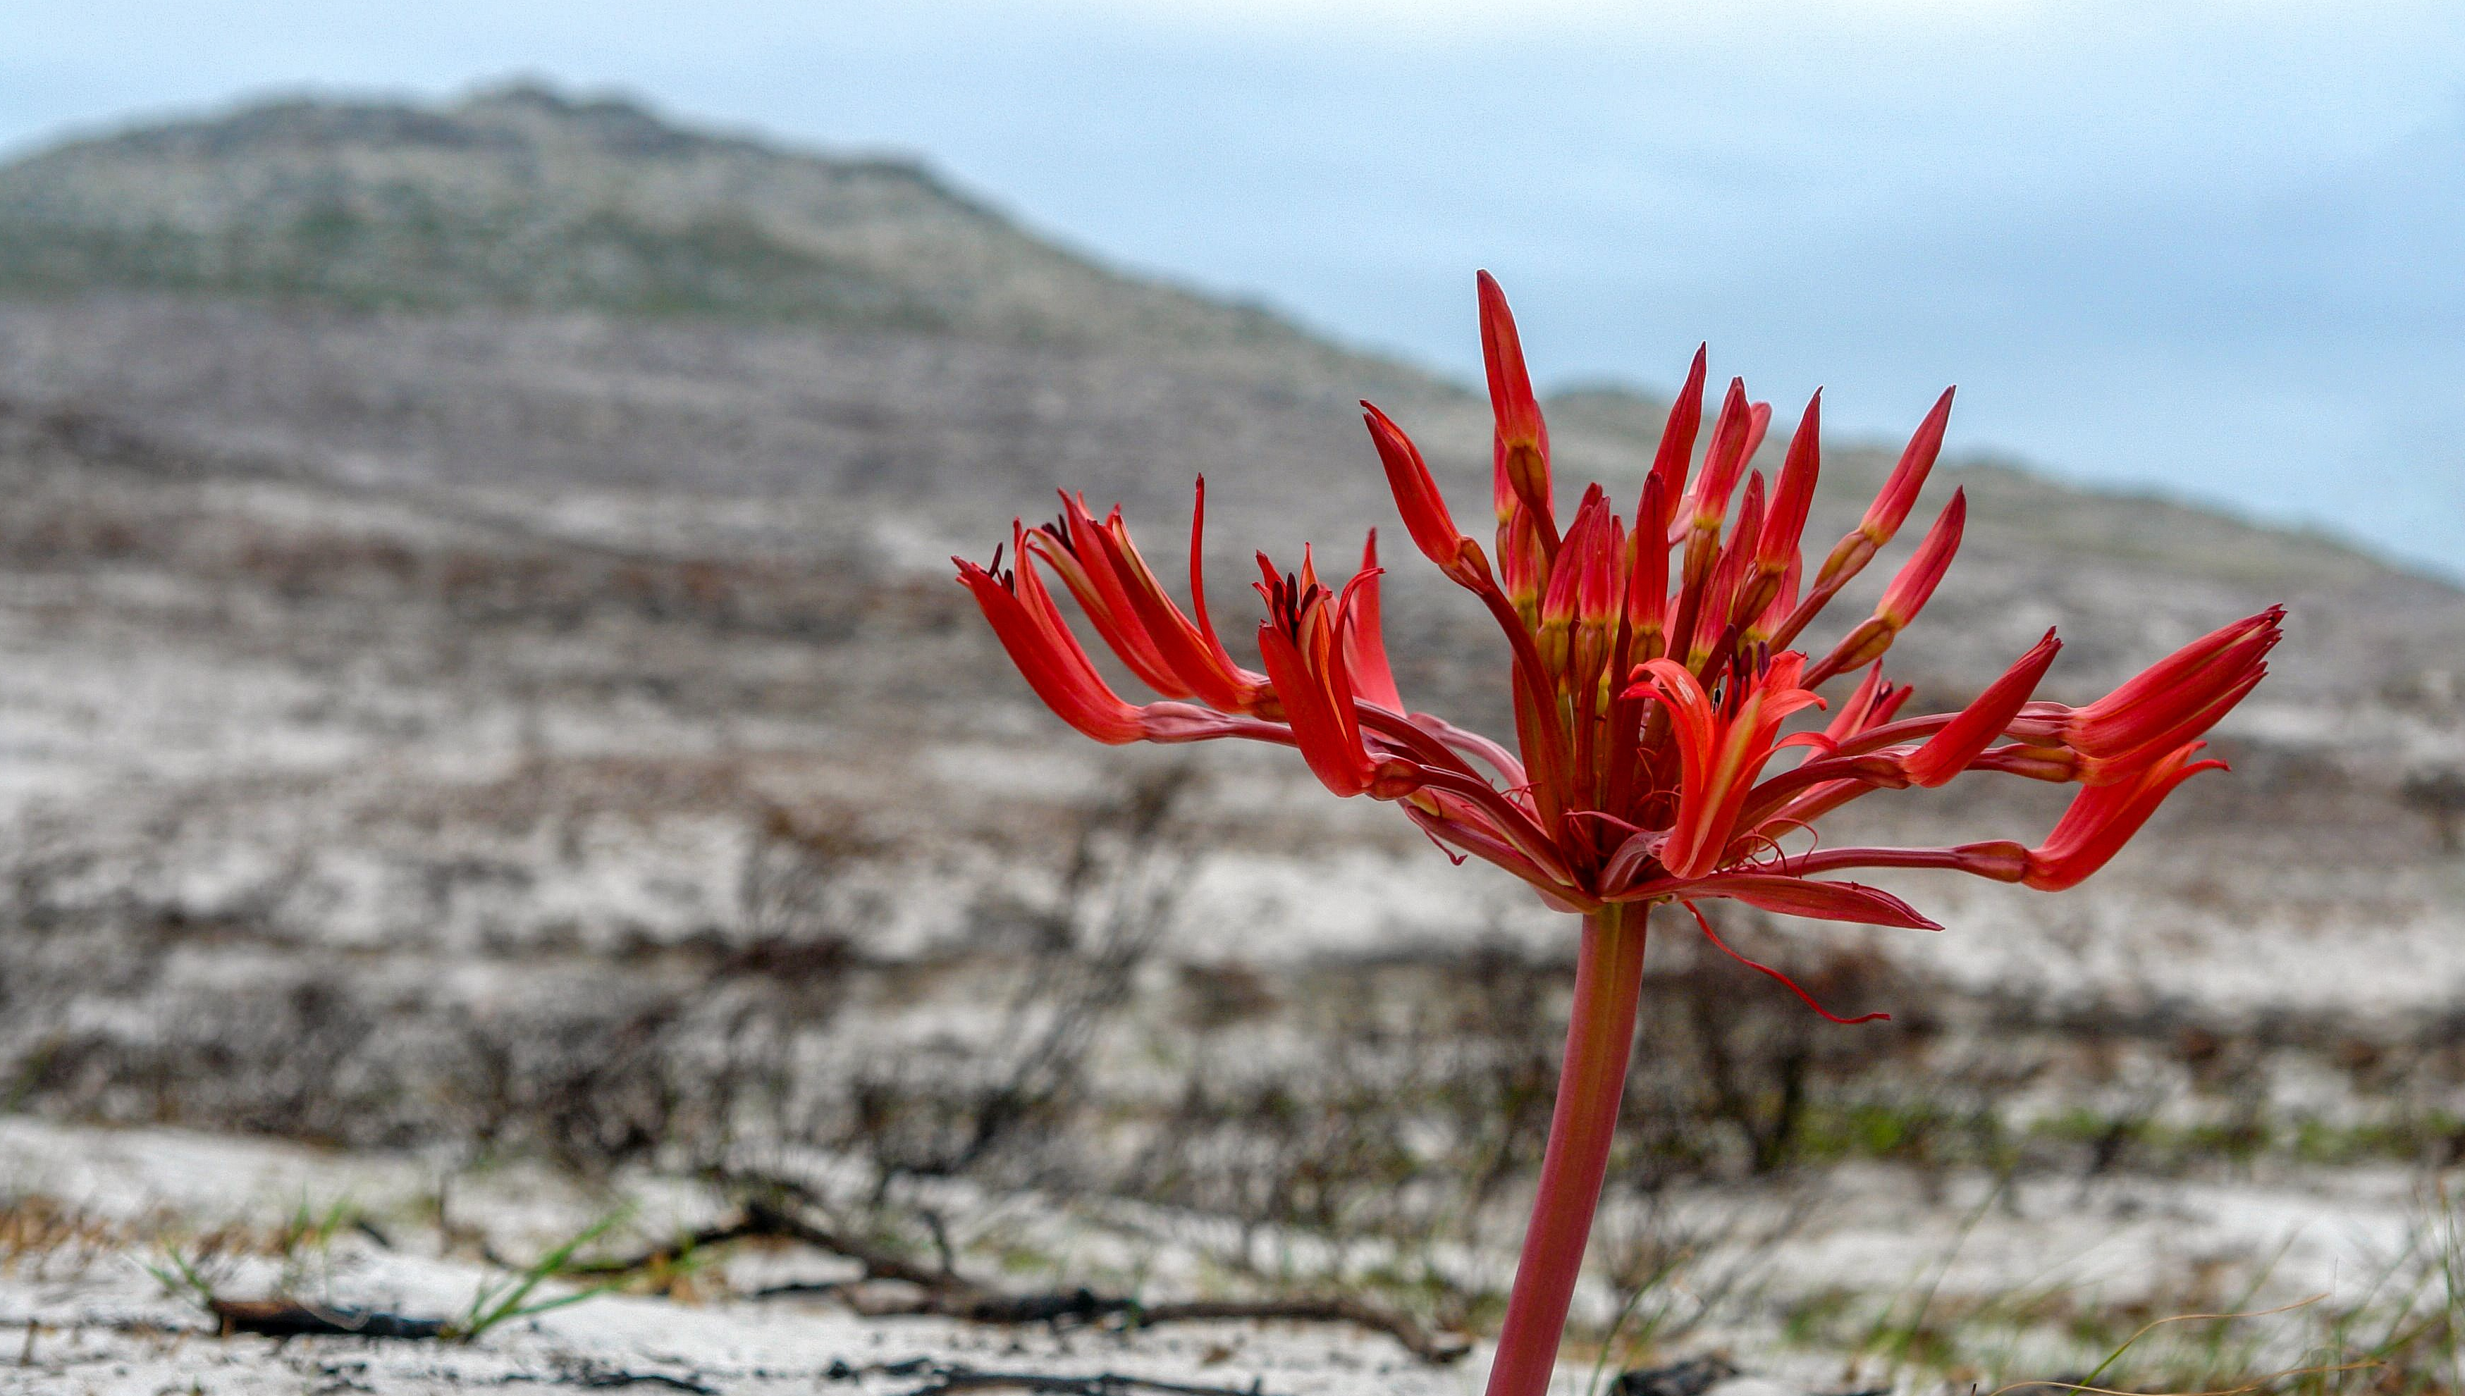
It may feel awkward, but studies show teens are great at making parents care about climate change.
Be open, gentle, and honest.
Try starting with “How do you feel about climate change?"
Notes:
“And it may feel awkward, but studies show teenagers are really good at spreading climate change awareness.” *click*
“Be open, be gentle, and be honest.” *click*
“You can start with, ‘How do you feel about climate change?’”
Source: D. F. Lawson, K. T. Stevenson, M. N. Peterson, S. J. Carrier, R. L. Strnad, and E. Seekamp, “Children can foster climate change concern among their parents,” Nat. Clim. Chang., vol. 9, no. 6, pp. 458–462, Jun. 2019.
Image source: https://medium.com/@UNDP/talking-about-climate-change-walking-the-line-between-hope-and-despair-6605cf757ba5

Slide 68
On the count of three, let’s all say,
“How do you feel about climate change?”
It’s hard, but it works.
Notes:
“Let’s practice: on the count of three, let’s all say, ‘How do you feel about climate change?’” *click*
“I know it’s hard, but it works.”
Notice: this slide has been updated since the filmed version.

Slide 69
One last perspective on why we need to talk…
Notes:
“I’d like to share last perspective on why we need to talk.” *click*
Video link: https://www.youtube.com/watch?v=ZItiZSSnKAE

Slide 70
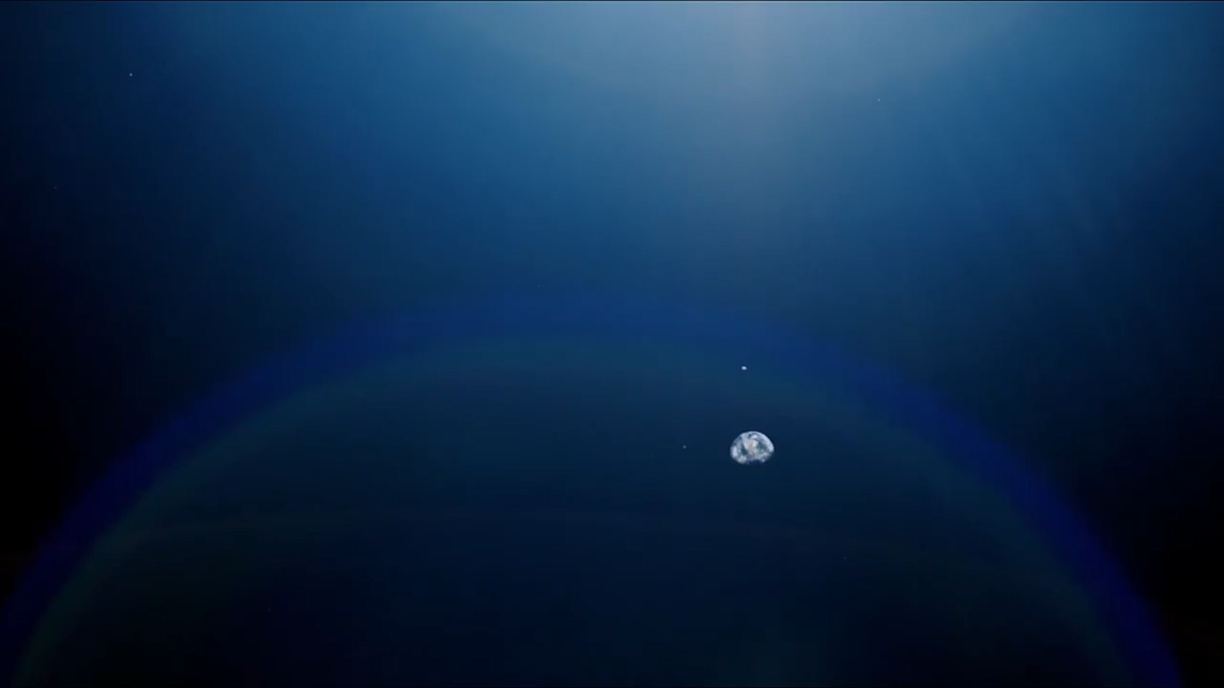
It’s not too late to keep our paradise.
But we can’t do it without you.
Notes:
“It’s not too late to keep our paradise.” *click*
“But we can’t do it without you.”

Slide 71
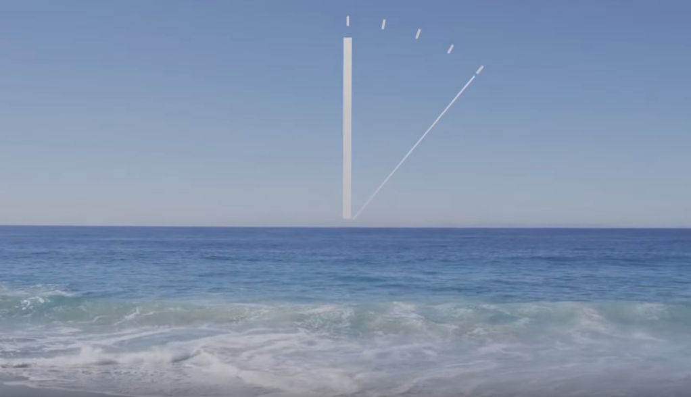
#FiveDayChallenge.
Write down the names of five people you can talk to about climate change.
Share your list with your neighbors.
Each day for the next five days,
talk about climate change
with someone on your list.
Notes:
“I’m going to leave you with a five-day challenge. Everyone write down the names of 5 people you can talk about climate change.”
*click*
“Share your list with the people sitting next to you”
*click*
“Each day for the next five days, I want you to talk with about climate change with someone on your list.”
Transition: “And remember…” *click*

Slide 72
Time is of the essence.
Notes:
“Time is of the essence.”
*pause before you click*
Image source: https://www.youtube.com/watch?v=B-nEYsyRlYo&t=240s © Connect4Climate. All rights reserved. This content is excluded from our Creative Commons license. For more information, see https://ocw.mit.edu/help/faq-fair-use/.

Slide 73
We Need to Talk.
www.TinyURL.com/ClimateHandoutA
Notes:
“Thank you.”
*pause to allow for applause*
“Please check out this website, you can pull out your phones and do it now – and I’m also happy to answer any questions you have now or later.”
[Public domain photo courtesy of NASA.]

